Slide 1
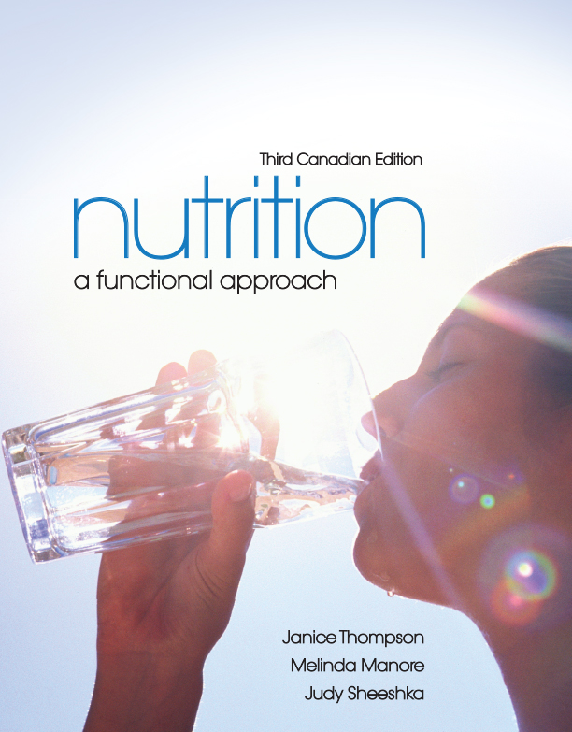
The Human Body:
Are We Really What We Eat?
and In Depth
[Insert new 3 Ce image here]

Slide 2
Why Do We Eat?
Food provides us with
  Energy for body processes
  Heat for body temperature regulation
  Building blocks for growth and maintenance of body tissues

Slide 3
Why Do We Want to Eat?
Hunger:
Appetite:

Slide 4
Why Do We Want to Eat?
Food is intimately connected to our sense of taste, but also stimulates our senses of
  Sight
  Smell
  Touch
  Hearing

Slide 5
Factors Affecting Hunger & Satiety
The hypothalamus region of the brain is the feeding centre
  Nerve cells in stomach and small intestine sense food and send message to hypothalamus
  Hormones relay messages to the hypothalamus
  Amount and type of food consumed influence satiety

Slide 6
Why Do We Want to Eat?
The signals that prompt us to eat include
  Nerve receptors in the stomach send signals to the hypothalamus to indicate if the stomach is full or empty
  Blood glucose levels trigger the release of hormones

Slide 7
Why Do We Want to Eat?
Hormones: chemicals produced in specialized glands that travel in the bloodstream to target organs in other parts of the body
  Some hormones stimulate hunger
  Some hormones produce a feeling of satiety

Slide 8
Why Do We Want to Eat?
Foods have differing effects on our feelings of hunger and satiety
  Proteins have the highest satiety value
  Carbohydrates have a lower satiety value than fats
  Bulky foods provide a sense of satiety
  Solid foods are more filling than semisolid foods or liquids

Slide 9
Organization of the Body
Atoms: the smallest units of matter
  Atoms bond to each other to form molecules
Molecules: groups of atoms bonded in specific configurations

Slide 10
Organization of the Body
Molecules are the building blocks of cells
Cells: the smallest unit of life

Slide 11
Organization of the Body
Cell membrane: outer layer enclosing each cell of the body
  Composed of 2 layers of phospholipids
  Long lipid “tails” face each other toward the interior of the membrane
  Phosphate “heads” line the interior and exterior surfaces of the membrane
  Cholesterol and proteins are embedded in the membrane

Slide 12
Organization of the Body
The cell membrane is selectively permeable, allowing it to control the passage of materials into and out of the cell
The cell membrane encloses the
  cytoplasm
  organelles

Slide 13
Organization of the Body
Cells join together to form tissues
Tissue
Different tissues combine to form organs
Organ
Organ systems

Slide 14
What Happens to the Food We Eat?
Gastrointestinal (GI) tract: series of organs arranged as a long tube through which the food passes
The GI tract includes
  Organs such as the stomach and intestines
  Sphincters: muscles that control the passage of material from one organ to the next

Slide 15
Digestion
First step:
Hunger and appetite combine to prepare GI tract to digest food
Nervous system stimulates release of digestive juices

Slide 16
Digestion: The Mouth
Digestion begins in the mouth
  Chewing is the mechanical digestion that breaks food into smaller pieces
  Some chemical digestion takes place in the mouth
    Salivary amylase

Slide 17
Digestion: The Mouth
  Digestion begins in the mouth (continued)
  The epiglottis covers the opening to the trachea during swallowing
  Food (“bolus”) travels from the mouth to the stomach through the esophagus
  Peristalsis is the muscular contractions moving food through the GI tract

Slide 18
Digestion: Stomach
The gastroesophageal sphincter separates the esophagus from the stomach
  Prevents the flow of food from the stomach back into the esophagus
Digestion in the stomach includes
  Mechanical digestion
  Chemical digestion

Slide 19
Digestion: Stomach
Gastric juice contains
  Hydrochloric acid (HCl)
  Pepsin
  Gastric lipase
  Mucus
Chyme: semisolid product of mechanical and chemical digestion in the stomach

Slide 20
Digestion: Small Intestine
Most digestion and absorption occur in the small intestine
From the stomach, chyme is slowly released through the pyloric sphincter to the small intestine
Chemical digestion continues in the small intestine using pancreatic enzymes and bile

Slide 21
Digestion: Accessory Organs
Surrounding the GI tract are several accessory organs
  Liver
  Pancreas
  Gall bladder

Slide 22
Absorption
Absorption: the process of taking molecules across a cell membrane and into cells of the body
A small amount of absorption occurs in the stomach
Most absorption of nutrients occurs in the 3 sections of the small intestine

Slide 23
Absorption
The lining of the GI tract has special structures to facilitate absorption
  Villi
  Brush border

Slide 24
Absorption
Water-soluble nutrients (carbohydrate, protein, minerals, and some vitamins) enter the portal vein
Fat-soluble nutrients (lipids and some vitamins) enter the lymphatic vessels

Slide 25
Elimination
Undigested food components move through a sphincter called the illeocecal valve to the large intestine
In the large intestine
  Very little digestion takes place
  Material is stored 12–24 hours prior to elimination
  Water and some nutrients are absorbed

Slide 26
Disorders Related to Digestion
The lining of the stomach is designed to cope with hydrochloric acid but other regions of the GI tract are not
Heartburn is caused by hydrochloric acid in the esophagus
Gastroesophageal reflux disease (GERD) is painful, persistent heartburn

Slide 27
Disorders Related to Digestion
Peptic ulcers are regions of the GI tract that have been eroded by HCl and pepsin
The bacterium Helicobacter pylori contributes to the production of both gastric and duodenal ulcers

Slide 28
Disorders Related to Digestion
Diarrhea
  Can be caused by
    Food intolerances
    Infection of the GI tract
    Stress
    Bowel disorders
  Can lead to severe dehydration
  Is more dangerous for children and the elderly
Constipation
  No stool passed for 2 or more days

Slide 29
Disorders Related to Digestion
Irritable bowel syndrome (IBS) is a disorder that interferes with normal colon function
Symptoms of IBS include
  Abdominal cramps and bloating
  Either diarrhea or constipation

Slide 30
Disorders Related to Digestion
Inflammatory Bowel Disease (IBD)
Term used to describe 2 autoimmune disorders
  Crohn’s disease
  Ulcerative colitis

Slide 31
In Depth: Disorders Related to Foods
Food intolerance
Food allergy

Slide 32
In Depth: Disorders Related to Foods
Celiac disease (aka Celiac sprue)
  Complete intolerance for gluten, a protein found in wheat, rye, barley, and triticale
  Can damage the small intestine, leading to poor absorption of nutrients
  Requires a diet lacking wheat, rye, barley & triticale
  There may be a genetic component to the disease
  Classified as an autoimmune disease

